Slide 1
OpenAPI autocompletion using deep learning methods
Bohdan Petryshyn
Supervised by Assoc. Professor Mantas Lukoševičius

Slide 2
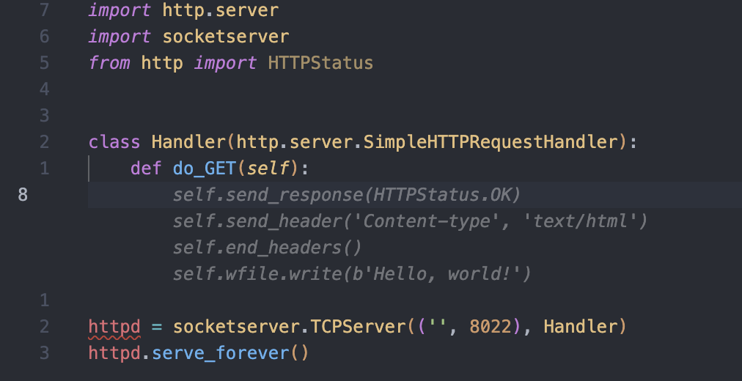
Terms - Code completion
Symbol auto-completion vs Context-aware autocompletion

Slide 3
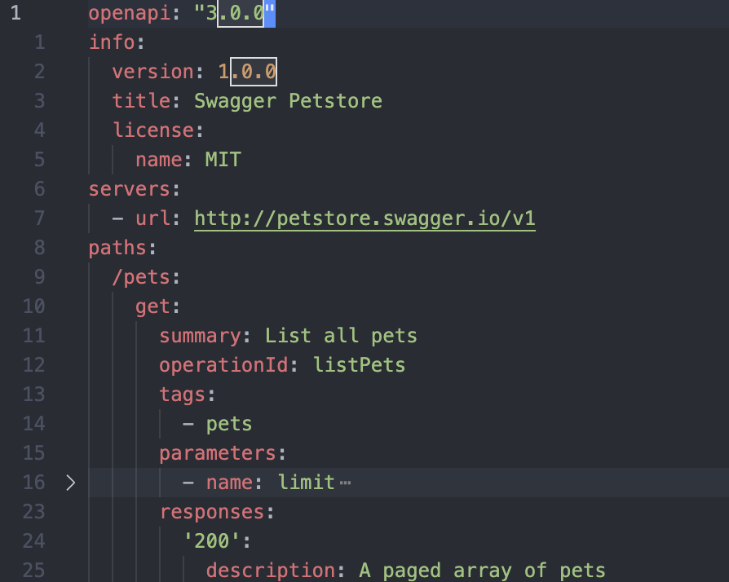
Terms - OpenAPI specification
Definition formats: JSON, YAML
Definition versions: 2.0, 3.0, 3.1

Slide 4
Problem
There are general-purpose programming language autocompletion tools that help to speed up development. However, their performance is not as great for less popular formats like OpenAPI.

Slide 5
Goal
This project aims to investigate deep learning language models trained on a variety of public OpenAPI definitions for auto-completion, measure their performance, and compare it to general-purpose programming language auto-completion tools.

Slide 6
Objectives
Research on natural language and programming language processing models
Develop metrics to measure the model performance
Train or fine-tune a model specifically for OpenAPI completion using a variety of public OpenAPI definitions
Compare the performance to existing general-purpose solutions

Slide 7

Existing solutions - GitHub Copilot
Based on the GPT-3 large language model
Very good at mainstream languages autocompletion: JavaScript, Java, Python
Not nearly as good at less popular formats: OpenAPI, Terraform
Other solutions: Kite

Slide 8
Training data
OpenAPI definitions are intended to be public
There are public OpenAPI definition directories with hundreds of definitions
API-guru registry
OpenAPI definitions are huge (thousands lines of code)

Slide 9
Conclusions
Transformer-based language models are considered to be the leading approach for code generation and auto-completion tasks.
Transformer-based language models are generally expensive to train due to the large number of parameters.
Existing code generation solutions are usually based on large general-purpose models and use fine-tuning for specific code generation tasks.
High computational requirements of transformer-based language models make it difficult to deploy the model to personal devices.

Slide 10
Literature
Evaluating Large Language Models Trained on Code - 2021
A deep language model for software code - 2016
A deep neural network language model with contexts for source code - 2018
Code completion with statistical language models - 2014
Code Completion with Neural Attention and Pointer Networks - 2018
Unified Pre-training for Program Understanding and Generation - 2021
Bert: Pre-training of deep bidirectional transformers for language understanding - 2018
Attention is all you need. Advances in neural information processing systems - 2017

